Slide 1



Light Detection and Ranging (LiDAR) Survey of a Sky Island Forest
Jimmy Mack
Thanks to
Tyson Swetnam, M.S.
School of Natural Resources, University of Arizona
Stephen Yool, Ph.D
Department of Geography and Regional Development, University of Arizona
Arizona Space Grant Consortium
Statewide Symposium
April 18, 2009

Slide 2

Perspective and Significance
Uncertainty regarding quantity and distribution of forest biomass (above ground carbon stores).
LiDAR is becoming more available, shown to be highly accurate at quantifying forest structure (Anderson et al. 2005, Reutebuch et al. 2005).
Unprecedented accuracy (typical R² > 0.90) (McGaughey et al. 2006), becoming more cost effective (<$0.50/acre).

Slide 3
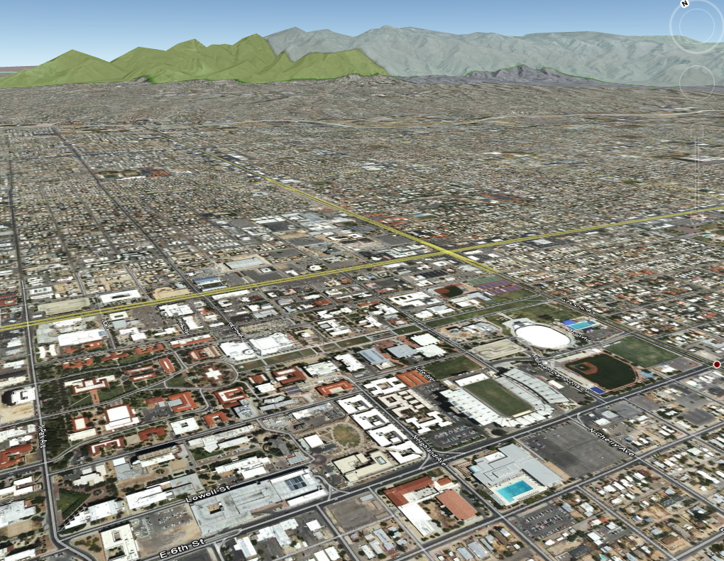
Objectives

Slide 4
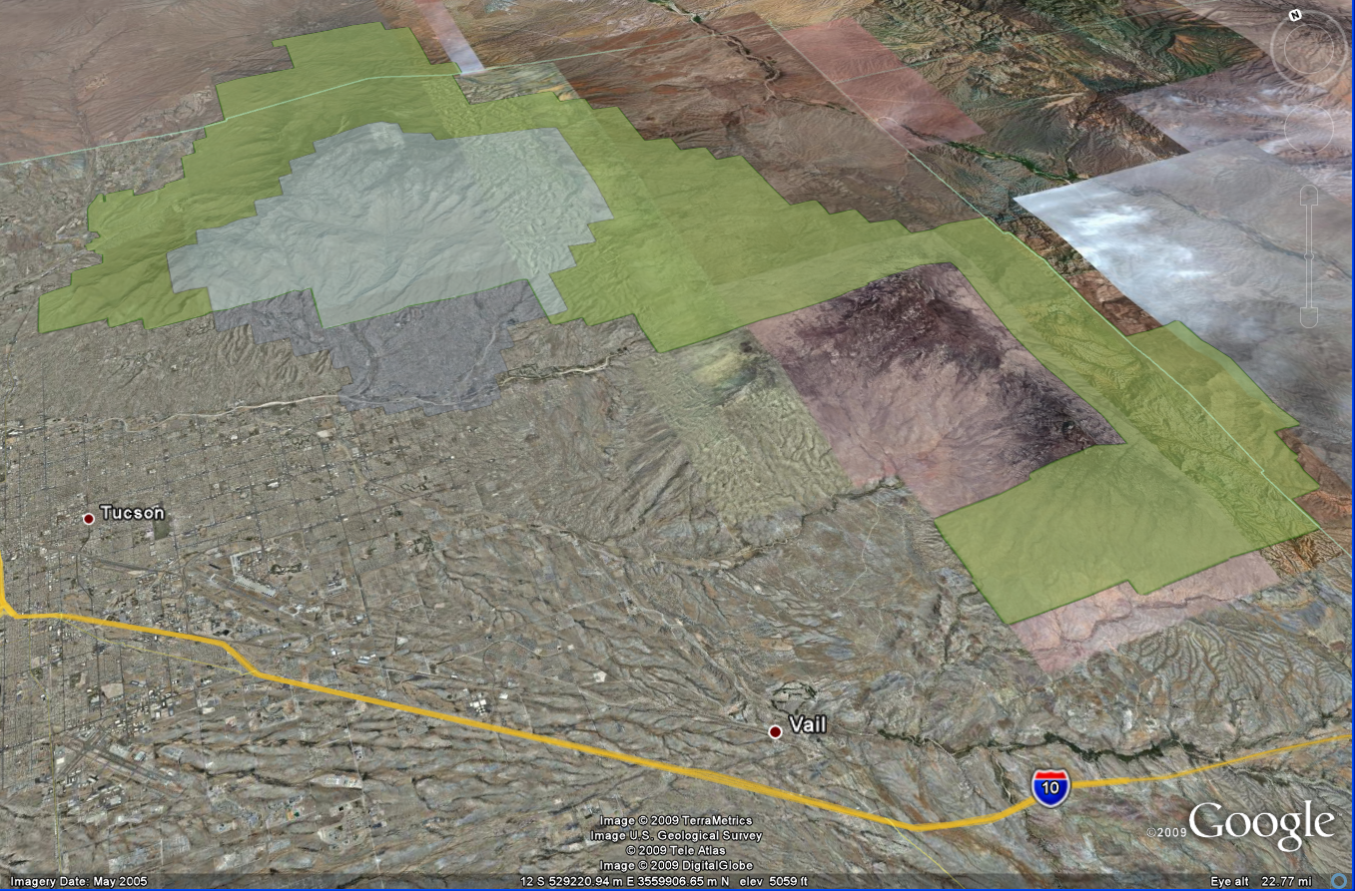

Slide 5
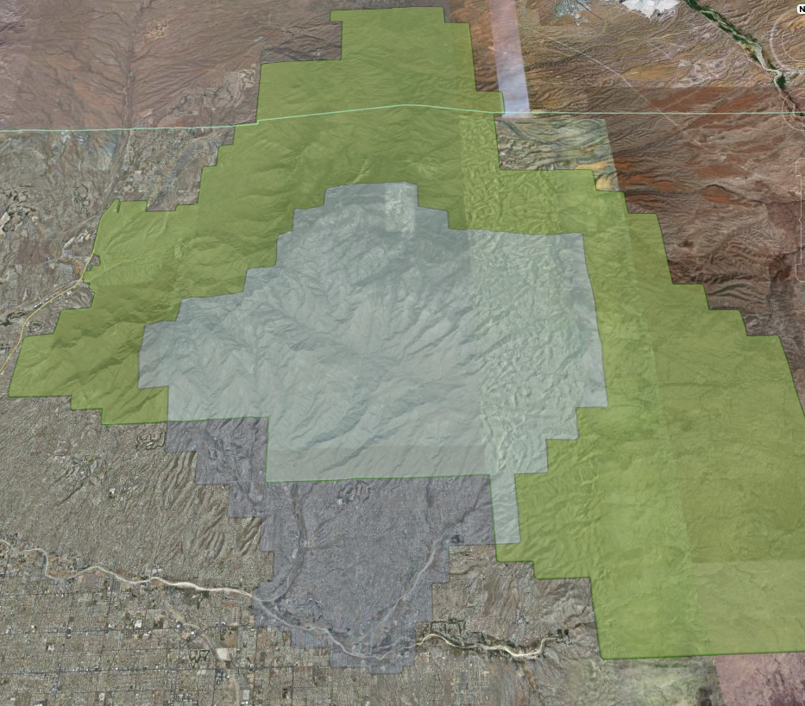
LiDAR data covering 31,857 hectares of forest land
Original purchase by Pima County Flood control
Santa Catalinas
“Sky Island”
Aspen (2003) and Bullock Fires (2002)

Slide 6
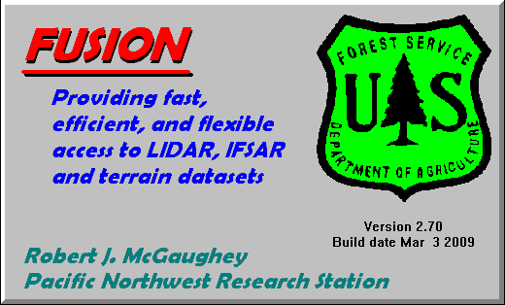
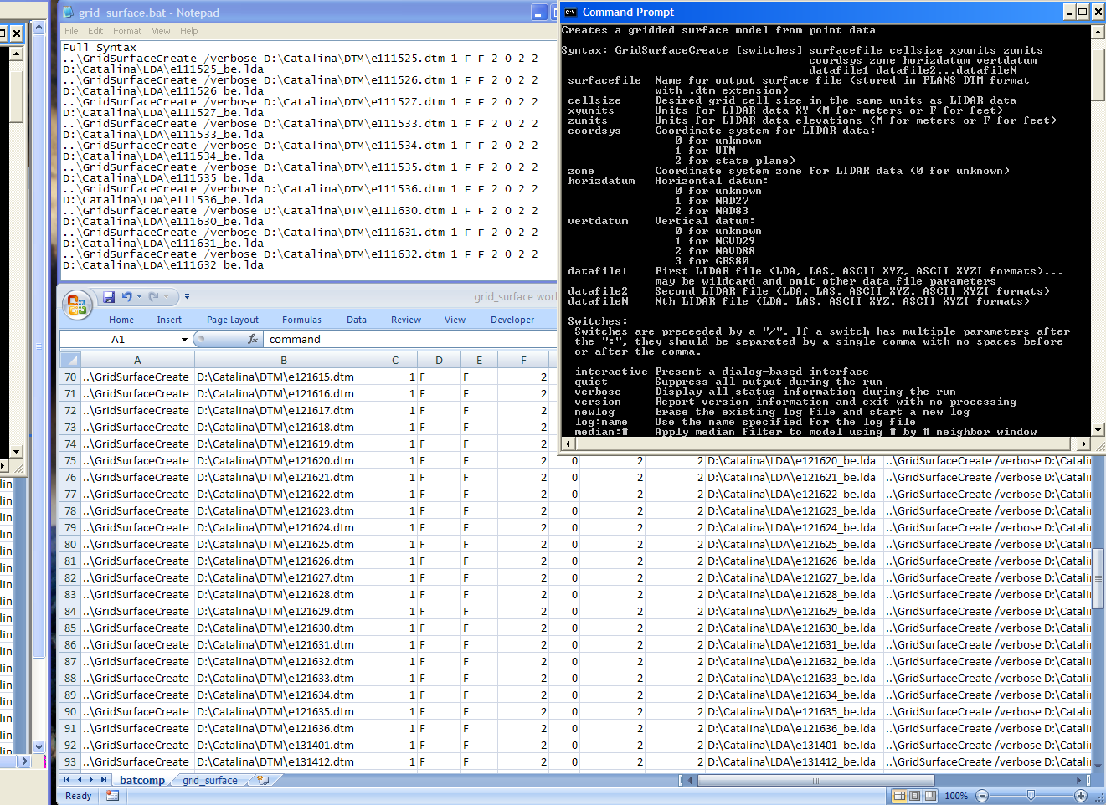




Data and Methods
Converted Log ASCII Standard (LAS) files to X,Y,Z format using Fusion
Digital Terrain Models
Canopy Height Models

Slide 7
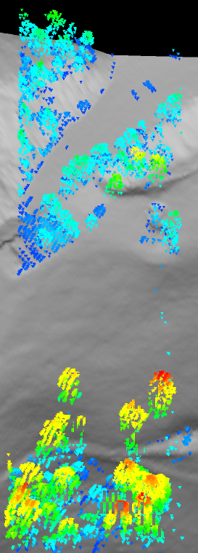
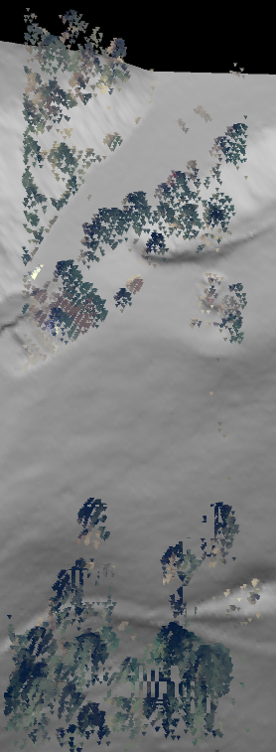
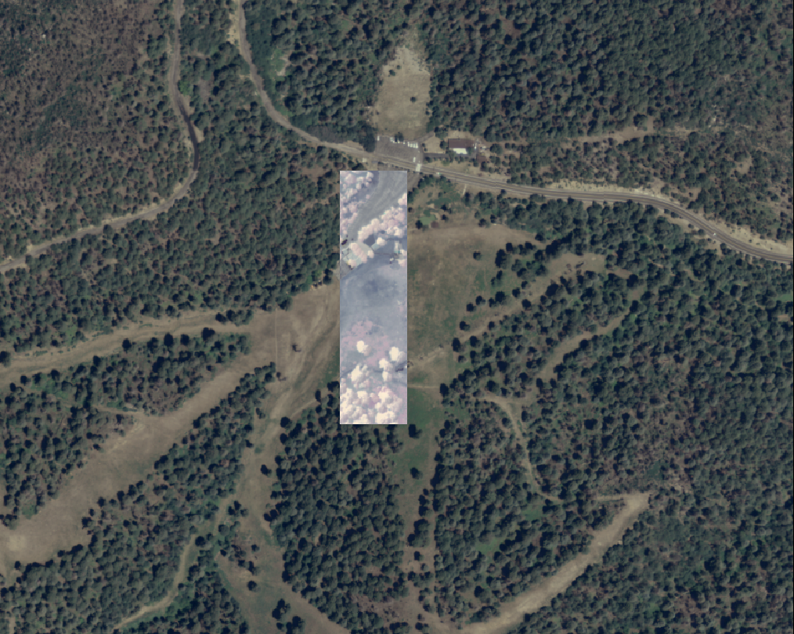
Results and Discussion

Slide 8
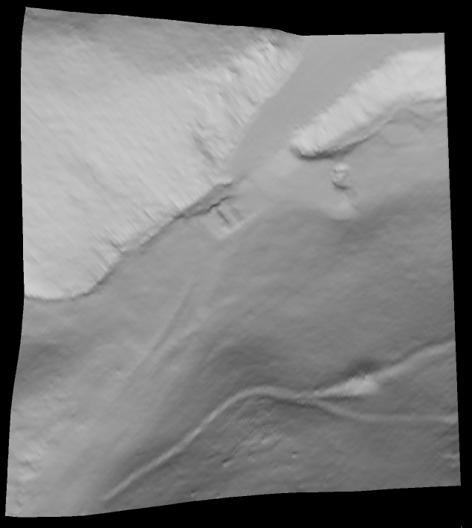
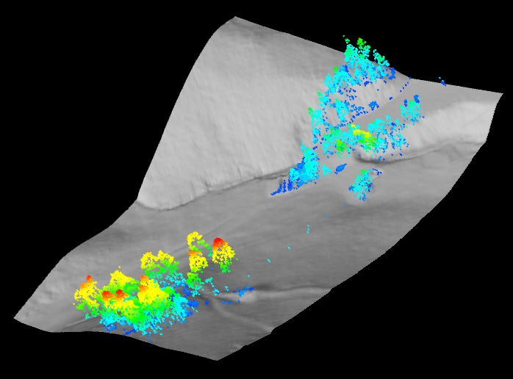
Results and Discussion continued

Slide 9
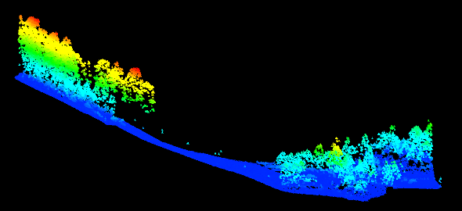
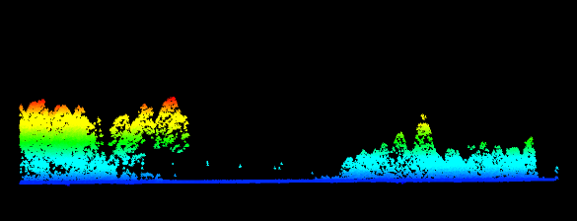
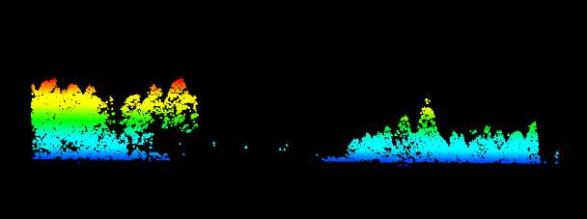
Results and Discussion continued
Vegetation and Surface Model
Surface Elevation Subtracted from Vegetation
Elimination of Surface Returns (0.7m and below)

Slide 10
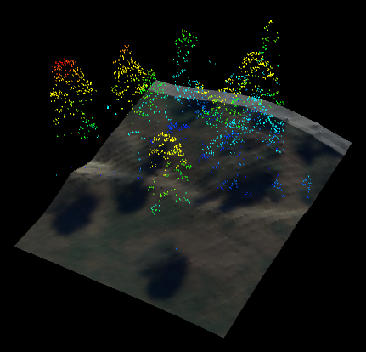
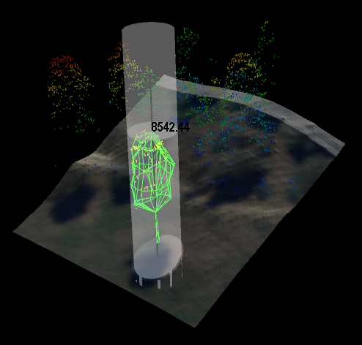
Results and Discussion continued
Calculation of Both Plot and Individual Tree Metrics (i.e. Canopy Diameter and Tree Height)

Slide 11
Ongoing Work
Summer field work to validate/reference LiDAR measurements
Stratification of vegetation by type, estimate biomass in kg/m²
Inclusion of Pinaleño Mountains and other southwestern “sky islands”

Slide 12
References
Andersen, H.-E., S.E. Reutebuch, and R.J. McGaughey. 2006. Chapter 3: Active remote sensing. In Computer Applications in Sustainable Forest Management, Edited by G. Shao and K. Reynolds. Springer-Verlag, Dordrecht.
Andersen, H.-E., R.J. McGaughey, and S.E. Reutebuch. 2005. Estimating forest canopy fuel parameters using LIDAR data. Remote Sensing of Environment 94(4):441-449.
McGaughey, R.J., H.-E. Andersen, and S.E. Reutebuch. 2006. Considerations for planning, acquiring, and processing LIDAR data for forestry applications. In Proceedings of the eleventh Biennial USDA Forest Service Remote Sensing Applications Conference, Salt Lake City, ID, April 24-28, 2006. American Society of Photogrammetry and Remote Sensing, Bethesda, MD.
McGaughey, R.J., W.W. Carson, S.E. Reutebuch, and H.-E. Andersen. 2004. Direct measurement of individual tree characteristics from LIDAR data. Proceedings of the Annual ASPRS Conference, Denver, May 23-28, 2004. American Society of Photogrammetry and Remote Sensing, Bethesda, MD.
Popescu, S.C., R.H. Wynne, and R.F. Nelson. 2003. Measuring individual tree crown diameter with lidar and assessing its influence on estimating forest volume and biomass. Canadian Journal of Remote Sensing 29(5):564-577.
Reutebuch, S.E., H.-E. Andersen, and R.J. McGaughey. 2005. Light detection and ranging (LIDAR): An emerging tool for multiple resource inventory. Journal of Forestry 103(6): 286-292.

